Slide 1
Comparative Analysis of Maze Path Planning Using Enhanced Sparse A* Algorithm with Obstacle Variations
Rohith Sundar Jonnalagadda Sai Veera Venkata Akshay Adabala Ramani Potlapati
KSU ID: 001093082 KSU ID: 001140226 KSU ID: 001125320

Slide 2
Introduction
For our project we implemented convex decomposition to simplify complex obstacle geometries into manageable convex shapes, facilitating easier computation. We utilized visibility graphs to represent navigable spaces effectively, connecting points that have a clear line of sight. Then we enhanced the traditional A* algorithm to work efficiently in complex environments by reducing the search space and improving path quality.
Applications:
Robotics: Autonomous robots navigating warehouses, factories, or disaster zones where obstacle avoidance is critical.
Autonomous Vehicles: Self-driving cars planning routes in dynamic urban environments with pedestrians, other vehicles, and infrastructure.
Unmanned Aerial Vehicles (UAVs): Drones operating in environments with physical obstacles like buildings, trees, or varying terrain elevations.
Industrial Automation: Automated guided vehicles (AGVs) in manufacturing settings requiring precise and efficient navigation among equipment and inventory.

Slide 3
Motivation
Challenges in Path Planning:
Traditional grid-based algorithms struggle with environments featuring irregularly shaped or densely packed obstacles, often resulting in suboptimal paths or failure to find a viable path.
High computational demands make real-time path planning difficult, especially in large-scale or intricate environments where quick decision-making is essential.
As the complexity and size of the environment increase, maintaining performance and efficiency becomes increasingly challenging.
Importance of Efficient Algorithms:
In critical applications like autonomous driving or robotic surgery, efficient and accurate path planning is paramount to prevent accidents and ensure operational safety.
Reducing computational overhead allows systems to allocate resources to other essential functions, such as sensor processing or decision-making.
Efficient algorithms can lead to lower energy usage, extending the operational time of battery-powered devices and reducing costs.
Key Question: Among all the path planning algorithms, A* is one of the efficient algorithm that uses heuristic approach so how can we enhance the A* algorithm to efficiently handle complex environments with irregular obstacles while ensuring scalability and maintaining optimal path quality?

Slide 4
Methodology
Image Preprocessing
Map Boundary and Obstacle Detection
Convex Decomposition
Optimized A* Algorithm
Visibility Graph Construction
Path Smoothing

Slide 5
Convex Decomposition
1. To simplify geometry we break down complex, non-convex polygons into a set of convex triangles, leveraging the fact that convex shapes are computationally simpler to handle.
2. Then we perform triangulation while respecting existing edges and boundaries, ensuring that triangles conform to the original map layout.
3. Also treat obstacles as holes within the triangulation, preventing the algorithm from creating triangles that span across obstacle areas.
Advantages
Reduced Computational Complexity: Convex polygons allow for straightforward algorithms for collision detection and other geometric operations.
Facilitates Visibility Graph Construction: Clear definitions of vertices and edges simplify the creation of the visibility graph.
Preserves Map Integrity: Maintains the essential features and constraints of the original map, ensuring realistic path planning

Slide 6
Optimized A* Algorithm
Advantages
Reduced Search Space: By using the visibility graph, the algorithm focuses only on key navigable paths, avoiding unnecessary exploration of irrelevant nodes.
Efficient Heuristic: The Euclidean distance provides a direct measure between nodes, improving the efficiency of the heuristic function in guiding the search.
Fewer Node Expansions: The algorithm expands significantly fewer nodes compared to traditional grid-based A*, leading to faster computation times.
Path Smoothing Details:
Bezier Curves: Implement Bezier curve fitting to the path to eliminate sharp angles and create smooth transitions between waypoints.
Collision Avoidance: During smoothing, continuously check for potential collisions with obstacles, adjusting the path as necessary to maintain safety.
Produces paths that are more suitable for physical systems, reducing wear on mechanical components and providing a more natural movement.

Slide 7
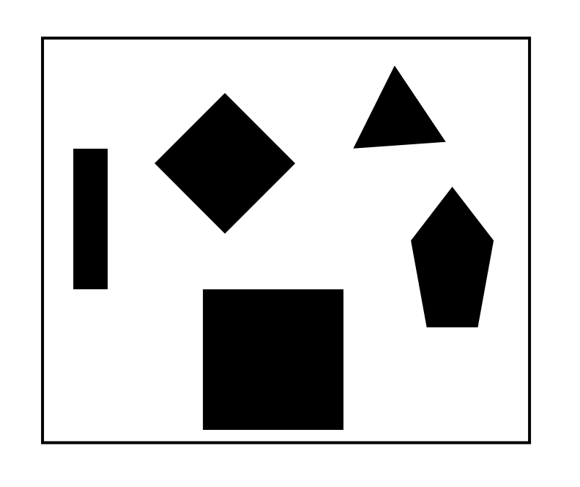
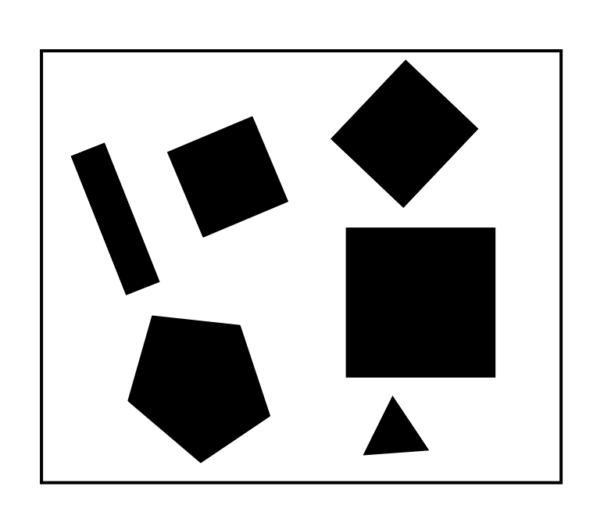
Experimental Setup
Maps Used:

Slide 8
Experimental Setup
Algorithms Compared:
Traditional grid-based A*, RRT, RRT*, PRM, and our improved A* algorithm.
Evaluation Metrics:
Path Length: Measures the total distance of the computed path; shorter paths are generally preferable.
Variance: Assesses the consistency of segment lengths in the path; lower variance indicates a smoother path.
Nodes Expanded: Counts the number of nodes the algorithm processed, indicating computational efficiency.
Time Taken: Total computation time from start to finish, critical for real-time applications.

Slide 9
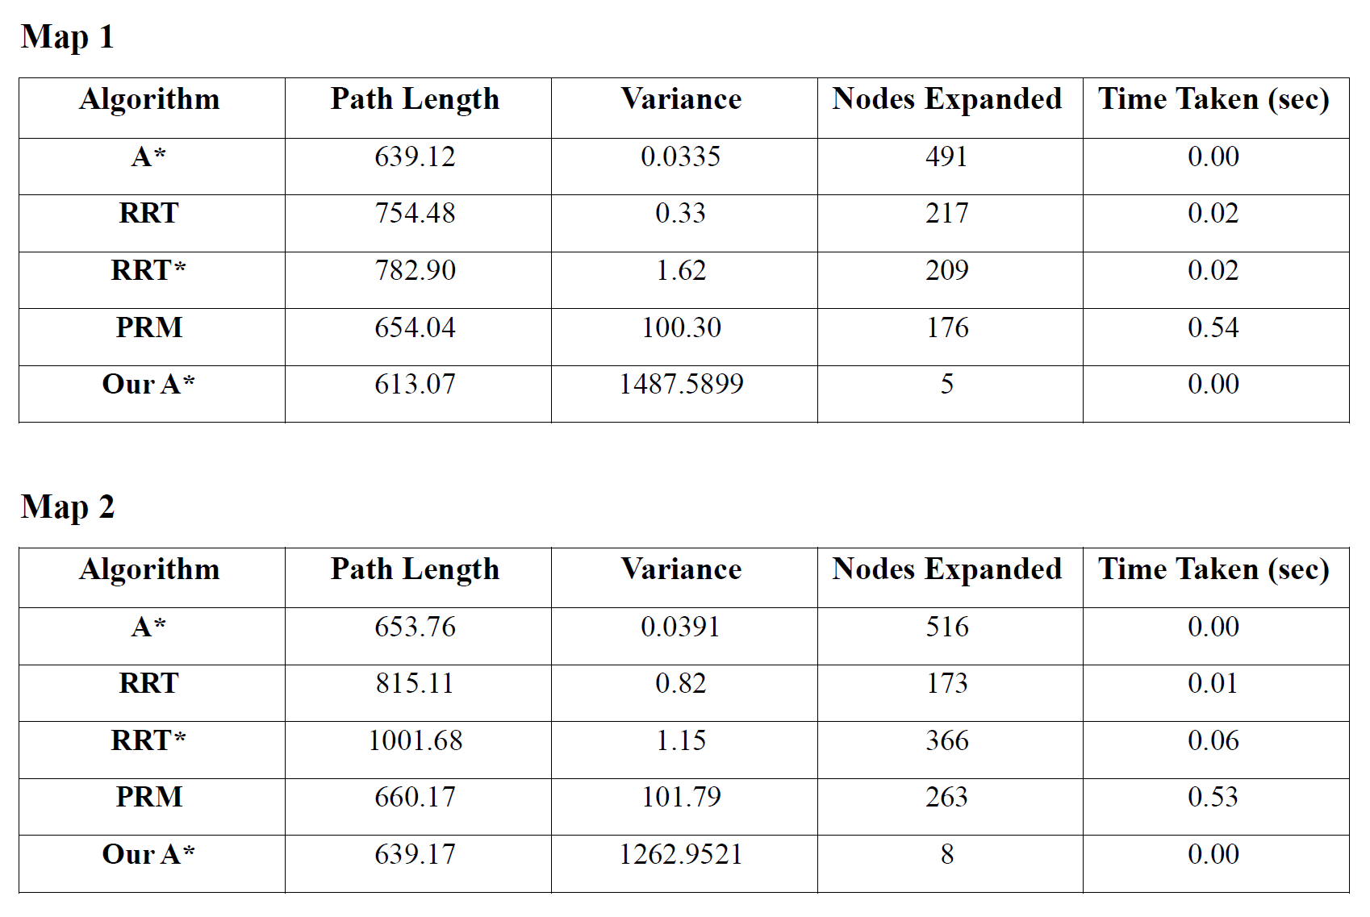
Results

Slide 10
Conclusion
We have developed an enhanced A* algorithm that significantly reduces computational requirements while finding optimal paths which has demonstrated the effectiveness of convex decomposition and visibility graphs in complex obstacle environments. Validated the algorithm through comparative experiments, showcasing superior performance over traditional methods.
Future Work:
Dynamic Environments: Adapt the algorithm to handle moving obstacles and changing environments in real-time.
Three-Dimensional Extension: Expand the methodology to 3D path planning for applications like drone navigation and robotic arms.
Machine Learning Integration: Incorporate learning algorithms to improve heuristic estimations or predict dynamic changes in the environment.

Slide 11
Thank You!

